Slide 1

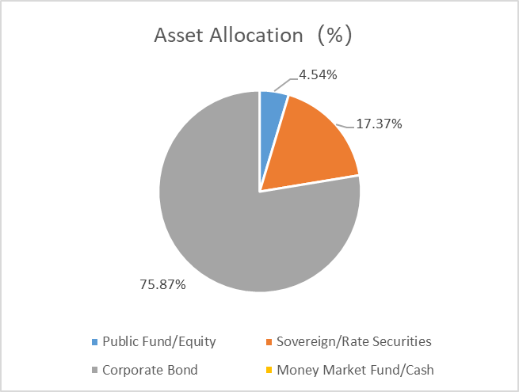
As of 31/7/2025
SWS STRATEGIC INVESTMENT FUNDS
Shenyin Wanguo RMB Mainland Investment Fund
申萬宏源投資管理（亞洲）有限公司
Shenwan Hongyuan Asset Management (Asia) Limited
The Product
The Shenyin Wanguo RMB Mainland Investment Fund (the “Sub-Fund”) invests primarily in RMB-denominated and settled debt securities issued in the PRC through a RQFII quota of the RQFII Holder which is a holding company of the Fund Manager.
Risk Disclosure
The investments of the Sub-Fund are concentrated on securities related to the PRC market. Investment in the PRC market is exposed to various emerging market risks including political, economic, regulatory, legal, foreign exchange, settlement and liquidity risks.
The Sub-Fund invests in securities through a RQFII which is subject to applicable rules and regulations imposed by the PRC authorities. The RQFII rules are novel in nature, and their application may depend on the interpretation of the Chinese authorities. Any changes to the relevant rules may have an adverse impact on the investment of investors in the Sub-Fund.
Renminbi is currently not freely convertible and is subject to exchange controls by the Chinese government. Investors may be adversely affected by the movement of the exchange rates between Renminbi and other currencies.
The Sub-Fund may be exposed to risks associated with changes in PRC tax laws. Such changes may have retrospective effect and may adversely affect the Sub-Fund.
Investment in the Sub-Fund is exposed to interest rate risk that applies to debt securities. The macro-economic policies and controls of the Chinese government will have significant influence over the capital markets in the Mainland China.
The Sub-Fund is exposed to credit risk arising from issuers of the RMB denominated debt securities in which it invests. Such securities are typically unsecured debt obligations and are not supported by collateral. The Sub-Fund is therefore fully exposed to the credit/insolvency risk of its counterparties as an unsecured creditor.
Investment grade securities invested by the Sub-Fund may be subject to the risk of being downgraded to below investment grade securities. The Manager may or may not dispose of the securities being downgraded. If the Sub-Fund continues to hold such securities, it will be exposed to additional risk of loss.
The RMB denominated debt securities market is at a developing stage and the trading volume may be lower than those of more developed markets. The Sub-Fund may invest in debt securities which are not listed. Even if the debt securities are listed, the market for such securities may be inactive. The Sub-Fund may suffer losses in trading such instruments.
Some of the RMB denominated debt securities invested by the Sub-Fund may be unrated or below investment grade. Such debt securities are exposed to greater risk because of generally lower credit worthiness and liquidity, greater fluctuation in value and higher chance of default than investment grade bonds.
Valuation of the investments of the Sub-Fund may involve uncertainties and judgmental determinations, and independent pricing information may not at all times be available. If such valuations are proved to be incorrect, the Net Asset Value of the Sub-Fund may be adversely affected.
Distributions of the Sub-Fund may be paid from income and/or capital of the Sub-Fund. The Sub-Fund or the Fund Manager may at its discretion pay dividend out of capital of the Sub-Fund. The payment of dividends out of capital represents and amounts to a return or withdrawal of part of original investment or from any capital gains attributable to that original investment. Any distributions involving payment of dividends out of the Sub-Fund’s capital may result in an immediate reduction of the Net Asset Value per Unit. The Sub-Fund or the Fund Manager may amend the Sub-Fund’s distribution policy with respect to payment of dividend out of the capital of the Sub-Fund subject to the SFC’s prior approval and by giving not less than one month’s prior notice to investors. The compositions of the dividends (i.e. the relative amounts paid out of (i) net distributable income and (ii) capital) for the last 12 months are available from the Fund Manager upon request and on the website of the Fund Manager at http://www.swhyhk.com Please note that the aforesaid website has not been reviewed by the Securities and Futures Commission of Hong Kong.
Fund Objective: The Sub-Fund aims at providing medium to long-term capital appreciation by investing primarily in RMB-denominated and settled debt securities issued in the PRC through a RQFII quota of the RQFII Holder which is a holding company of the Manager.
Market Review In July 2025, domestic bond market yields continued to rise. For government bonds, the 10-year treasury yield increased steadily throughout the month, eventually closing at 1.7196% on July 31, up by 5 basis points (BPs) from the previous month. The 1-year treasury yield also rose, reaching 1.3760%, with the yield curve shifting upward in parallel. In the credit bond market, net financing in the primary market for credit bonds continued to decline in July, mainly due to a contraction in the issuance of local government financing vehicles (LGFVs). Credit bond spreads narrowed overall, but term spreads slightly widened. Additionally, the DR007 rate rose from 1.4% at the beginning of the month to 1.65% by month-end, while the R001 transaction volume decreased from 69.7 trillion yuan to 59.7 trillion yuan, indicating tighter market liquidity compared to the previous month. Market Outlook and Strategy Looking ahead to August, the Ministry of Finance announced that, starting from August 8, 2025, interest income from newly issued government bonds, local government bonds, and financial bonds will once again be subject to value-added tax (VAT), while existing bonds (including reissued portions) will remain exempt. Following the announcement, the bond market remained stable. However, we estimate that the impact will be limited in 2025, but there could be some pressure on bank costs starting from 2026. Comments on portfolio This month, the net asset value (Class I) return of RQFII funds was -0.06%, while the ChinaBond Composite Full Price Index (CBCFPI) recorded -0.26% for the month. The fund slightly outperformed the index, primarily due to a decline in equity assets at the end of the month, which impacted the fund's overall monthly return. As of the end of July, the portfolio held approximately 93.24% in bonds, of which 22.31% were convertible bonds, a decrease compared to the previous period. Public funds/equities accounted for 4.54%, reflecting an increase in equity allocation. Most corporate bonds held were investment grade. By the end of July, the fund's average duration was 1.47 years, with an average yield to maturity of 2.17%. The portfolio consisted of 27 holdings, ensuring full diversification.
Fund Manager Shenwan Hongyuan Asset Management (Asia) Limited
Base Currency | RMB
Launch Date | 5 March 2012
Unit NAV | A類: RMB 85.699 I 類: RMB 92.171
Dividend Policy | Quarterly (Dividend policy is subject to the Manager’s discretion. Periodic distribution of dividend is not guaranteed. If distributed, dividend amount is not guaranteed. Please also see footnote 1)
Minimum Subscription Amount | Class A:RMB 10,000 (Initial) RMB 5,000(Subsequent) Class I: RMB 10,000,000(Initial) RMB100,000(Subsequent)
Bloomberg | Class A: SHWRMBA HK Class I: SHWRMBI HK
ISIN | Class A: HK0000098407 Class I: HK0000098415
Reuters | Class A: 68125485 Class I: 68125486
Cumulative Return （Footnote 1 & Footnote 2) | 1 month | 3 months | 6 months | 1 year | 3 years | 5 years | YTD | Since Launch
Class A | -0.12% | 0.71% | -0.11% | 2.14% | -2.22% | -3.28% | -0.04% | 18.43%
Class I | -0.06% | 0.88% | 0.25% | 2.85% | -0.78% | -1.15% | 0.36% | 24.95%
Fees and Charges
Subscription Fee | Class A & Class I: Up to 5%
Management Fee | Class A: 1.2% p.a. Class I: 0.5% p.a.
Trustee Fee | Class A & Class I: Up to 1% p.a. (subject to a minimum monthly fee of USD4,000 for each class of units)
RQFII Custodian Fee | Class A & Class I: Up to 0.5% p.a. (excluding transaction charges)
Performance Fee | N/A
Redemption Fee | N/A
Source : Shenwan Hongyuan Asset Management (Asia) Limited
Last update: 31 Jul 2025
Top 5 Holdings (% of Assets)
CGB 1.59 04/25/25 SH | 9.42%
CGB 2.22 09/25/25 | 7.94%
BOSHAI VAR 01/25/27 | 7.28%
GZFINH 3.5 03/07/27 | 6.48%
HTSC 4.5 01/29/26 | 6.48%
Duration and YTM*
Average Duration (Year) | 1.47
Average Yield to Maturity (%) | 2.17
For enquiries, please contact
Hotline: (852) 2509-8372
Email: swaminfo@swhyhk.com
Website:www.swhyhk.com
*Average Duration and Average YTM do not include the data of Money Market Fund and Cash.
Footnote 1 : The investment returns are denominated in RMB. US/HK dollar-based investors are therefore exposed to fluctuations in the US/HK dollar/RMB exchange rate.
Footnote 2 : Performance is calculated on NAV to NAV (RMB), with dividends reinvested ,net of fees. The performance data are compared to include all dividends that have been distributed.
Warning Statement
This Document is for information purpose only and does not constitute a prospectus, an offer or an invitation to subscribe any securities, or a recommendation in relation to any securities. Investment involves risks. Investors should not make investment decisions based on this material alone; before making any investment decision, investors should carefully read the explanatory memorandum and the product key facts statement of the Sub-Fund for further details including the risk factors. Past performance information presented are not indicative of future performance. Though the Sub-Fund has been authorized by the Securities and Futures Commission of Hong Kong, such authorization does not imply any official recommendation. The Sub-Fund may not be suitable for individual investor and may not be suitable for everyone. Information contained in this report has been obtained from sources believed to be reliable but Shenwan Hongyuan Asset Management (Asia) Limited does not guarantee the accuracy and completeness of the information provided by third party. This material has not been reviewed by the Securities and Futures Commission of Hong Kong.
Issued by: Shenwan Hongyuan Asset Management (Asia) Limited.
Notes:
1

